Slide 1
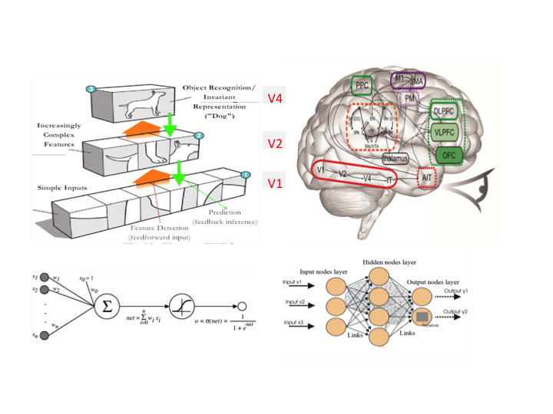
And Now For Something
Completely Different
(again)

Slide 2
Software Defined Intelligence A New Interdisciplinary Approach to Intelligent Infrastructure
David Meyer
Networking Field Day 8
http://techfieldday.com/event/nfd8/
09.11.2014
dmm@{brocade.com, 1-4-5.net, uoregon.edu,…}

Slide 3

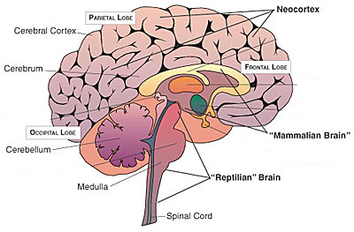
Remember this Slide?
The Evolution of Intelligence
Precambrian (Reptilian) Brain to Neocortex → Hardware to Software
HARDWARE
SOFTWARE
Clearly SDN wasn’t about doing the same
things that we’ve been doing, just in different
ways. Rather, the promise of SD(x) is much more intelligent CSNSE (“networks”).
Universal Architectural Features of Scalable/Evolvable Systems
RYF-Complexity
Bowtie architectures
Massively distributed control
Highly layered with robust control
Component reuse
Once you have the h/w
its all about code

Slide 4
Goals for this Talk
The goal of this talk is to introduce
the concept of Software Defined
Intelligence (SDI) and provide a
brief overview of one of its
foundational technologies, Machine
Learning. Time permitting, we’ll also
look at a few applications of SDI in a
“network setting”.

Slide 5
Agenda
Software Defined Intelligence
Very Brief Overview of Machine Learning
Artificial Neural Networks
Network-oriented Applications

Slide 6
Software Defined Intelligence
Software Defined Intelligence (SDI) is a new discipline that joins Software Defined “Networking” with Machine Learning (ML)
Where Networking ≈ CSNSE (and probably more)
SDI foundations: Data Science and Machine Learning
First applications will be in “Network Learning”
Predict eminent DDOS rather than reacting to an existing DDOS
“the probability you will experience a DDOS is 0.05”
More generally: “Predictive” Security
http://siliconangle.com/blog/2014/03/28/predictive-security-goes-beyond-the-network/
Detecting spam prefixes in the Internet routing table based on various data sources
https://www.usenix.org/legacy/events/sec09/tech/full_papers/sec09_network.pdf
http://www.bgpmon.net/using-bgp-data-to-find-spammers/
Larger goal: Uncover new relationships and structure in network data
Again, network ≈ CSNSE (and more)
Trivial example: “Better Data Centers Through Machine Learning”
Compute a function (PUE)
http://googleblog.blogspot.com/2014/05/better-data-centers-through-machine.html

Slide 7
Why ML for Networking?
Proliferation of network traffic (volume and type)
Increased complexity of network and traffic monitoring and analysis
Difficulty in predicting and generalizing application behavior
Too many sources of knowledge to process by humans
Too many black boxes → tasks that cannot be well-defined other than by I/O examples
Need for aggregated value solutions: getting the most out of our data
…

Slide 8
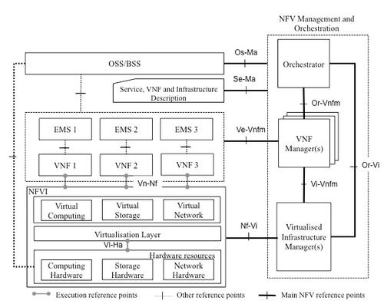
SDI Scope
SDI
SDSec
….
Orchestration
(Neutron, Nova, Swift/Cinder, Heat,..)
NFV
SDx Applications
SDN
SDC
SDStor
SDE
SDSense
…
Virtual CSN/Sensors
Physical Compute/Storage/Networking/Energy (CSNE)
Sensors

Slide 9
Agenda
Software Defined Intelligence
Very Brief Overview of Machine Learning
Artificial Neural Networks
Network-oriented Applications

Slide 10
What is Machine Learning?
Machine Learning (ML) is about computational approaches to learning
In particular, ML seeks to understand the computational mechanisms by which experience can lead to improved performance in both biological and technological systems
→ ML is data driven
Quasi-technically: ML consists of algorithms that improve their performance P on some task T through a set of experiences E:
A well defined learning task is given by <T,P,E>
T → 0-day attack detection
P → Detection/false positive rates
E → Attack free set of traffic flows (flow descriptors for normal traffic)
Defn due to Tom Mitchell, Chair CMU ML Department
To put even more it directly: The ever increasing amount of network data is good reason to believe that smart data analysis will become even more prevasive as a necessary ingredient for technological progress…

Slide 11
What is Machine Learning, Redux?
A trained learning algorithm (e.g., neural network, boosting, decision tree, SVM, …) is very complex. But the learning algorithm itself is usually very simple. The complexity of the trained algorithm comes from the data, not the algorithm.
-- Andrew Ng
(S)he who has the best data wins
ML is “all” about data
(note: who owns that data?)
Note that this is a good thing; we know how to come up with
complex data (its all around us), but coming up with complex
algorithms is well, hard.

Slide 12
The Same Thing Said in Cartoon Form
Traditional Programming
Data
Computer
Output
Program
Machine Learning
Data
Computer
Program
Output

Slide 13
BTW, One Thing That Jumps Out From The Previous Slide…
While almost everything else in the networking
stack obviously commoditizes over time…
Intelligence Doesn’t Commoditize
Keep this in mind/give some thought to this during our discussion(s)

Slide 14
Examples of Successful Application of Machine Learning Problems
Pattern Recognition
Facial identities or facial expressions
Handwritten or spoken words (e.g., Siri)
Medical images
Sensor Data/IoT
Optimization
Many parameters have “hidden” relationships that can be the basis of optimization
Pattern Generation
Generating images or motion sequences
Anomaly Detection
Unusual patterns in the telemetry from physical and/or virtual plants (e.g., data centers)
Unusual sequences of credit card transactions
Unusual patterns of sensor data from a nuclear power plant
or unusual sound in your car engine or …
Prediction
Future stock prices or currency exchange rates
Security/infrastructure events
Robotics
Autonomous car driving, planning, control
Notably Missing: Compute, Storage, Networking
(security, energy, sensors, …)

Slide 15
Ok, So When Would We Use Machine Learning?
When patterns exists in our data
Even if we don’t know what they are
Or perhaps especially when we don’t know what they are
We can not pin down the functional relationships mathematically
Else we would just code up the algorithm
When we have lots of (unlabeled) data
Labeled training sets harder to come by
Data is of high-dimension
High dimension “features”
For example, sensor data
Want to “discover” lower-dimension representations
Dimension reduction
Find higher level abstractions
Pixel vs. edge, edge vs. shape, shape vs. semantic object
Note that Machine Learning is heavily focused on implementability
And uses well know techniques from calculus, vector mathematics, probability theory, and optimization theory →TINM (There Is No Magic)
Lots of open source code available
See e.g., libsvm (Support Vector Machines): http://www.csie.ntu.edu.tw/~cjlin/libsvm/
Most of my code has been in Python, but java, …
Octave: handy for numerical computation: http://en.wikibooks.org/wiki/Octave_Programming_Tutorial

Slide 16
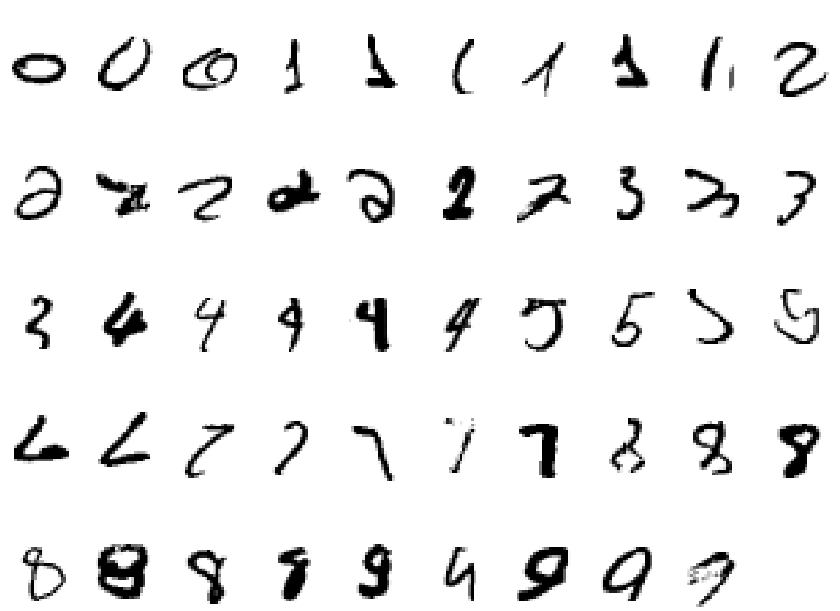
BTW, Why Machine Learning Hard? What is a “2”?

Slide 17
Kinds of Machine Learning
Supervised (inductive) learning
Training data includes desired outputs
“Labeled” data
Discrete Label: Classification
Continuous Label: Regression
All kinds of “standard” training data sets available, e.g.,
http://archive.ics.uci.edu/ml/ (UCI Machine Learning Repository)
http://yann.lecun.com/exdb/mnist/ (subset of the MNIST database of handwritten digits)
http://deeplearning.net/datasets/
…
Unsupervised learning
Training data does not include desired outputs
“Unlabeled” data
Transfer Learning
Use knowledge from other domains in an new/related domain
Semi-supervised learning
Training data includes a few desired outputs
Reinforcement learning
Rewards from sequence of actions

Slide 18
Agenda
Software Defined Intelligence
Very Brief Overview of Machine Learning
Artificial Neural Networks
Network-oriented Applications

Slide 19
Artificial Neural Networks
A Bit of History
Biological Inspiration
Artificial Neurons (AN)
Artificial Neural Networks (ANN)
Computational Power of Single AN
Computational Power of an ANN
Training an ANN -- Learning

Slide 20
Brief History of Neural Networks
1943: McCulloch & Pitts show that neurons can be combined to construct a Turing machine (using ANDs, ORs, & NOTs)
1958: Rosenblatt shows that perceptrons will converge if what they are trying to learn can be represented
1969: Minsky & Papert showed the limitations of perceptrons, killing research for a decade
1985: The backpropagation algorithm revitalizes the field
Geoff Hinton et al

Slide 21
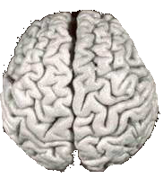

Biological Inspiration: Brains
200 billion neurons, 32 trillion synapses
Element size: 10⁻⁶ m
Energy use: 25W
Processing speed: 100 Hz
Parallel, Distributed
Fault Tolerant
Learns: Yes
~128 billion bytes RAM but trillions of bytes on disk
Element size: 10⁻⁹ m
Energy watt: 30-90W (CPU)
Processing speed: 10⁹ Hz
Serial, Centralized
Generally not Fault Tolerant
Learns: Some
We will revisit the architecture of the brain if we get the time to talk about
we talk about deep learning

Slide 22
Biological Inspiration: Neurons
A neuron has
A branching input (dendrites)
A branching output (the axon)
Information moves from the dendrites to the axon via the cell body
Axon connects to dendrites via synapses
Synapses vary in strength
Synapses may be excitatory or inhibitory
A Neuron is a computational device

Slide 23
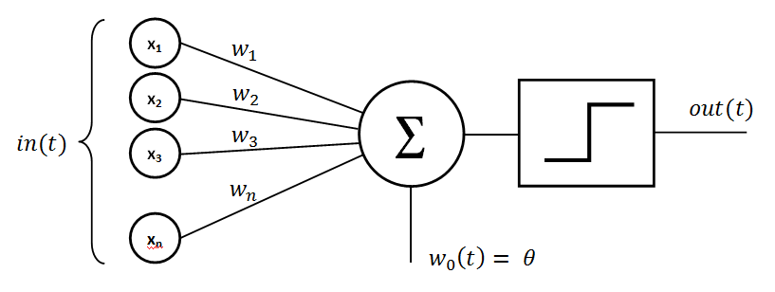
Basic Perceptron (Rosenblatt, 1950s and early 60s)
Step function

Slide 24
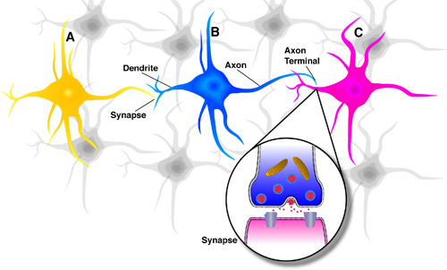
What is an Artificial Neuron?
An Artificial Neuron (AN) is a non-linear parameterized function with restricted output range
activation function
y
b
w₁
w₂
w₃
x1
x2
x3

Slide 25
What does g(.) look like? (activation functions)
Linear
No input squashing
Logistic
Squash input into [0,1]
Hyperbolic tangent
Squash input into [-1,1]

Slide 26
Ok then, what is a Neural Network?
An Artificial Neural Network (ANN) is mathematical model designed to solve engineering problems
Group of highly connected neurons to realize compositions of non-linear functions
Major types of Tasks
Classification: Automatically assigning a label to a pattern
Can think about this as the case where you have discrete labels
Regression: Predicting the output values for some function
Can think about this as the case where you have continuous labels
Generalization: Extracting a model from example data
2 types of networks
Feed forward Neural Networks
Recurrent Neural Networks (can have loops)
Can be generative

Slide 27
Feed Forward Neural Networks
Artificial Neurons
The information is propagated from the inputs to the outputs
Directed graph
Computes one or more non-linear functions
Computation is carried out by composition of some number of algebraic functions implemented by the connections, weights and biases of the hidden and output layers
Hidden layers compute intermediate representations
Dimension reduction
Time has no role -- no cycles between outputs and inputs
Output layer
2nd hidden
layer
1st hidden
layer
x₁
x₂
…..
x_{n}
We say that the input data are n dimensional. The hidden layers are called “features”.

Slide 28
Machine Learning?
Defn: Machine Learning is a procedure that consists in estimating the parameters of neurons so that the whole network can perform a specific task
2 main types of learning
Supervised
Unsupervised
Semi-supervised learning
Reinforcement learning
Transfer learning
Supervised learning
Present the network a number of inputs and their corresponding outputs
See how closely the actual outputs match the desired ones
Modify the parameters to better approximate the desired outputs
Unsupervised
Network learns internal representations and important features
And BTW, where does the learning take place?

Slide 29
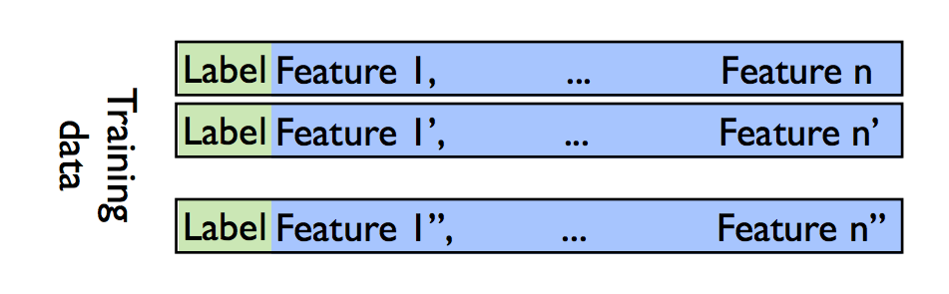
Supervised learning
In this case the desired response of the neural network as a function of particular inputs is well known
i.e., you have a training set which inputs to outputs
Training set provides examples and teach the neural network how to fulfill a certain task
Notation
{(x⁽⁰⁾₁, …, x⁽⁰⁾_{n}, y⁽⁰⁾), (x⁽¹⁾₁,…,y⁽¹⁾),…,(x^{(m)}₁, …, x^{(m)}_{n}, y^{(m)})}
The x’s are input values, y’s are corresponding know output values (“labels”)
Think of it like a table of size m in which the i^{th} row has the format
(x^{(i)}₁, …, x^{(i)}_{n}, y^{(i)})

Slide 30
Unsupervised learning
Basic idea: Discover unknown structure in input data
Deep unsupervised learning is where all the action is…
Data clustering and dimension reduction
More generally: find the relationships/structure in the data set
Perhaps the “true” meaning of abstraction
No need for labeled data
The network itself finds the correlations in the data
Learning algorithms include (there are many)
Auto-encoders (denoising, stacked)
http://machinelearning.org/archive/icml2008/papers/592.pdf
http://jmlr.org/papers/volume11/vincent10a/vincent10a.pdf
Restricted Boltzmann Machines
https://www.cs.toronto.edu/~hinton/absps/guideTR.pdf
Hopfield Networks
K-Means Clustering
Sparse Encoders
...

Slide 31
Well, How About Brains?
Brains learn
How? By altering strength between neurons
Creating/deleting connections
Have a deep architecture
Use both supervised and unsupervised learning
Hebb’s Postulate (Hebbian Learning)
When an axon of cell A is near enough to excite a cell B and repeatedly or persistently takes part in firing it, some growth process or metabolic change takes place in one or both cells such that A's efficiency, as one of the cells firing B, is increased
That is, learning is about adjusting weights and biases
Long Term Potentiation (LTP)
Cellular basis for learning and memory
LTP is the long-lasting strengthening of the connection between two nerve cells in response to stimulation
Discovered in many regions of the cortex
“One Learning Algorithm” Hypothesis
Caution on “biological inspirations”

Slide 32
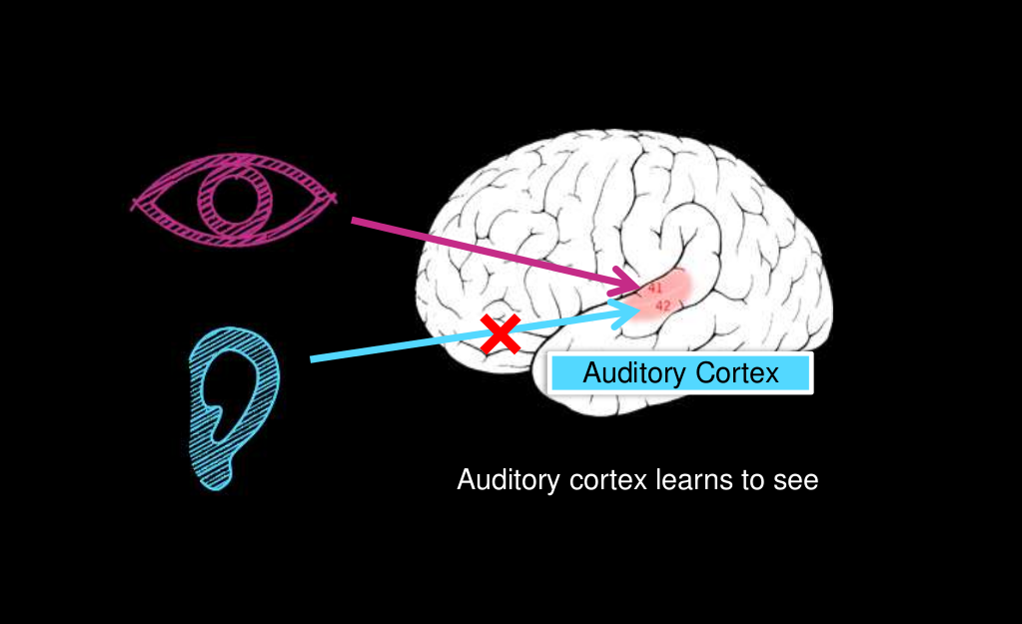
One Learning Algorithm Hypothesis
Neural Rewiring Experiment
(Roe et al., 1992. Hawkins & Blakeslee, 2004)

Slide 33
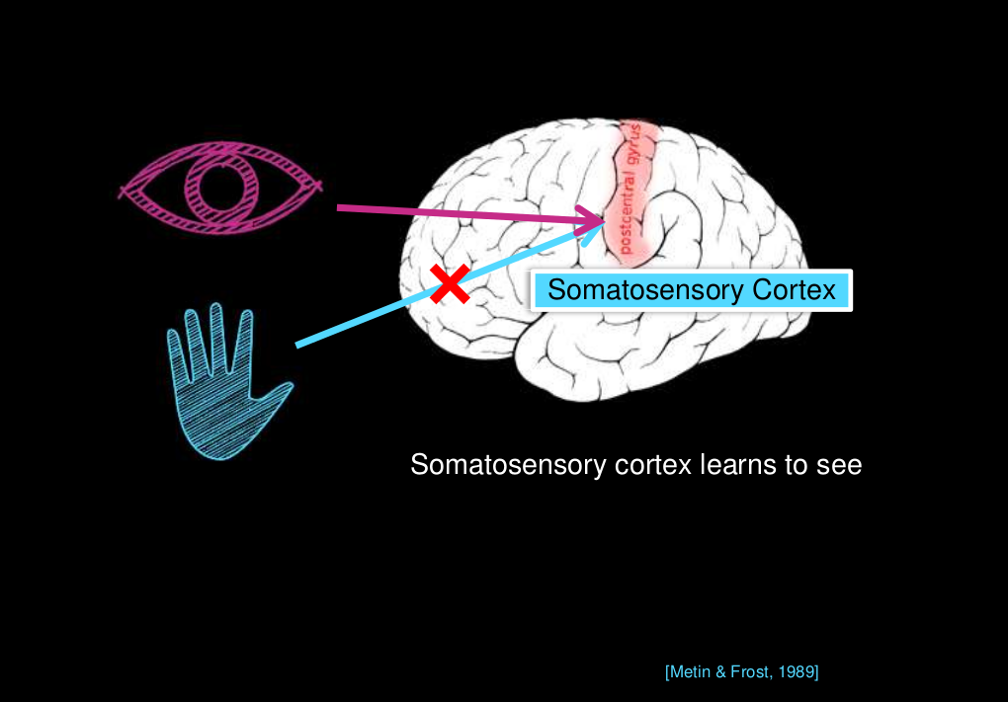
OLA Effect Is Quite Generalized
Inspiration: Wouldn’t it be better if we didn’t
have “custom” learning algorithms or features?

Slide 34
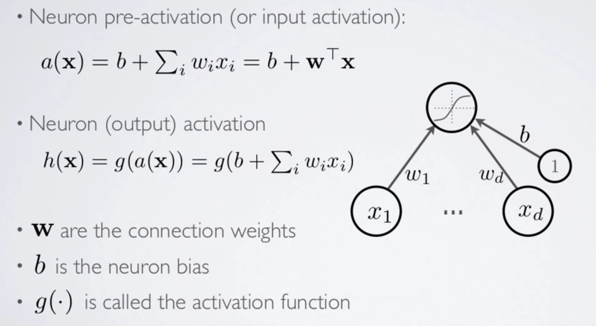
Artificial Neuron – Deeper Dive
h(x) ~ h_{θ}(x)

Slide 35
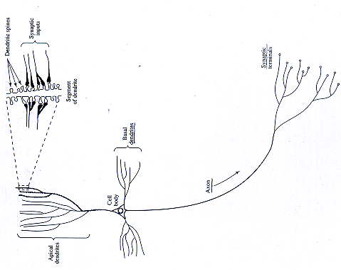
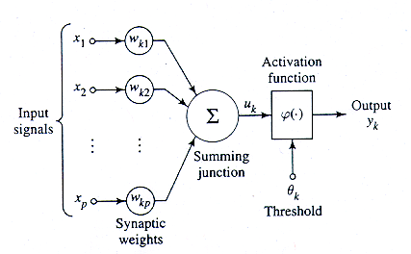
Review: Mapping to Biological Neuron
Dendrite
Cell Body
Axon

Slide 36
Summary: Artificial neurons
An Artificial Neuron is a (usually) non-linear parameterized function with restricted output range
y
w0
w₀ also called a bias term (b_{i})
x1
x2
x3

Slide 37
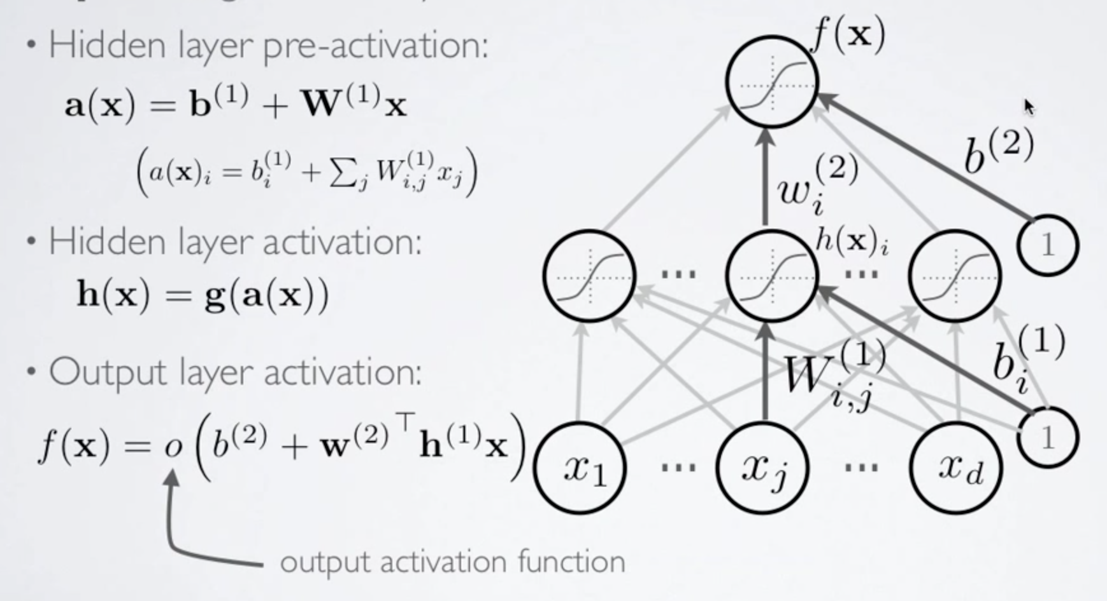
Putting it All Together Single Hidden Layer Neural Network (SHLNN)

Slide 38
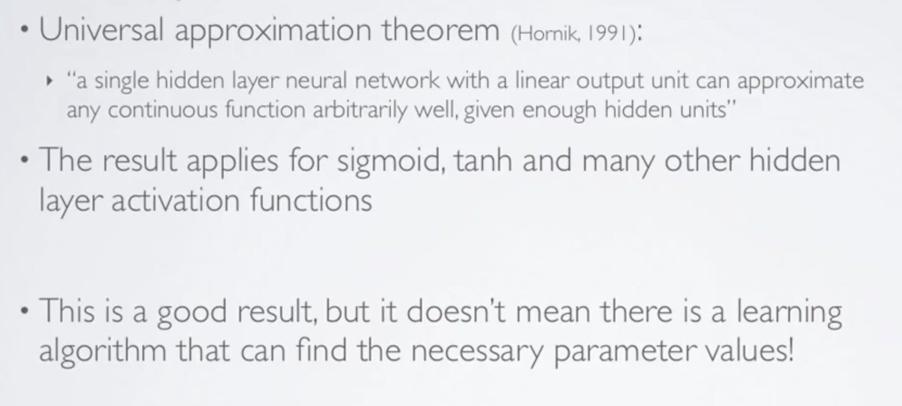
Universal Approximation Theorem (what can a SHLNN compute?)
Bad news: The single hidden layer neural network can be exponentially large

Slide 39
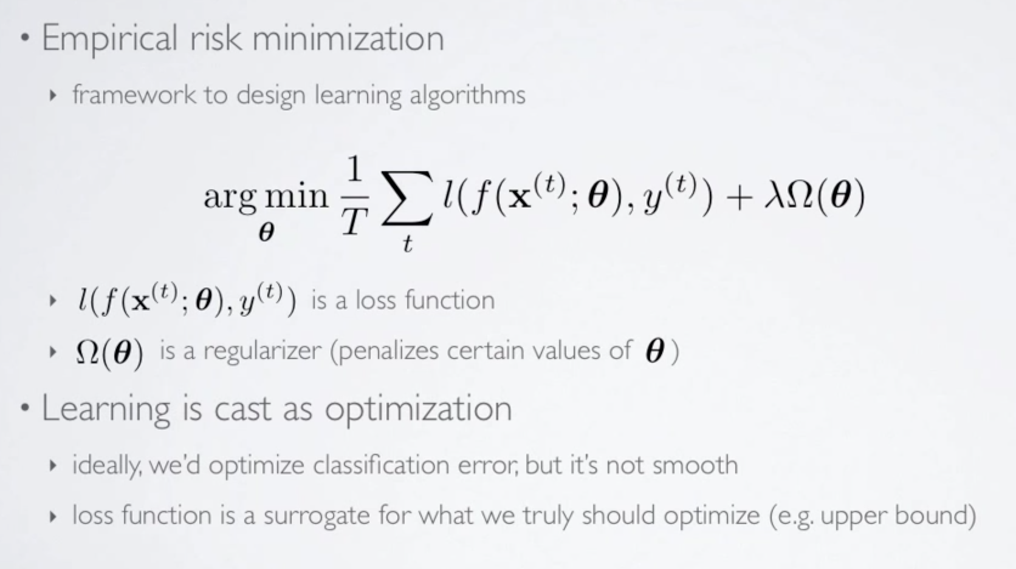
All Good, But How Does Learning Work? Empirical Risk Minimization (ERM) Learning Cast as Optimization
(loss function also called “cost function” denoted J(θ))
Any interesting cost function is not differentiable and non-convex

Slide 40
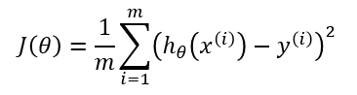
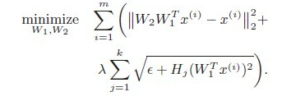
What Does J(θ) Typically Look Like? (Cost Functions)
Simple Cost Function
Google Autoencoder Cost Function¹
1
http://static.googleusercontent.com/media/research.google.com/en/us/archive/unsupervised_icml2012.pdf

Slide 41
Ok, but how do we use ERM in a Learning Algorithm?
Randomly initialize the model parameters θ
Implement forward propagation
Compute the cost function J(θ)
Implement the back propagation algorithm
Repeat steps 2-4 until convergence
or for the desired number of iterations
Big breakthrough
Hinton et al

Slide 42
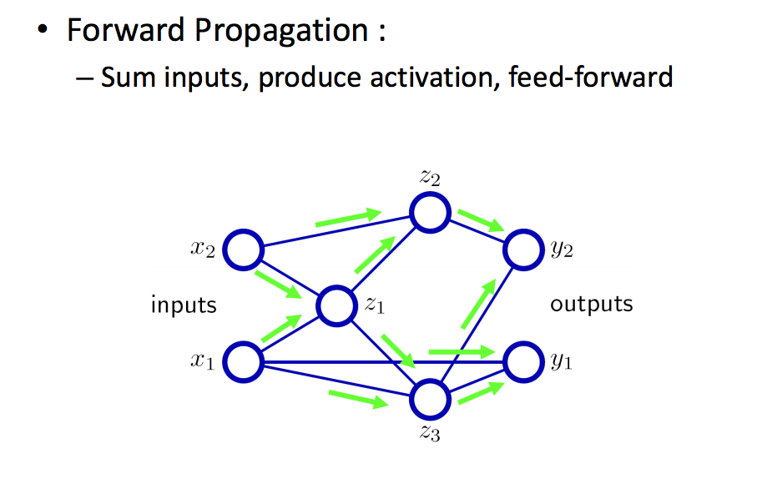
Forward Propagation Cartoon

Slide 43
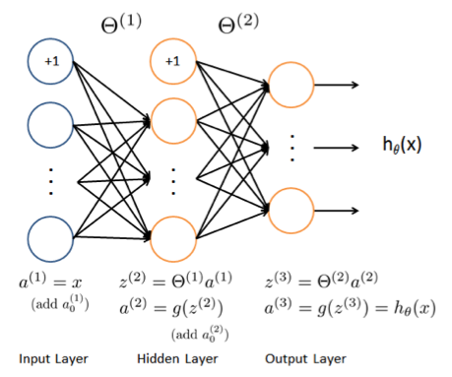
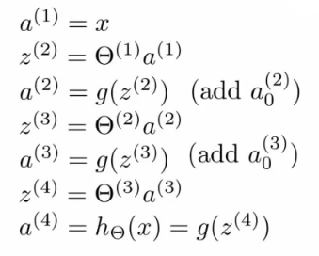
Doing the Math Forward Propagation

Slide 44
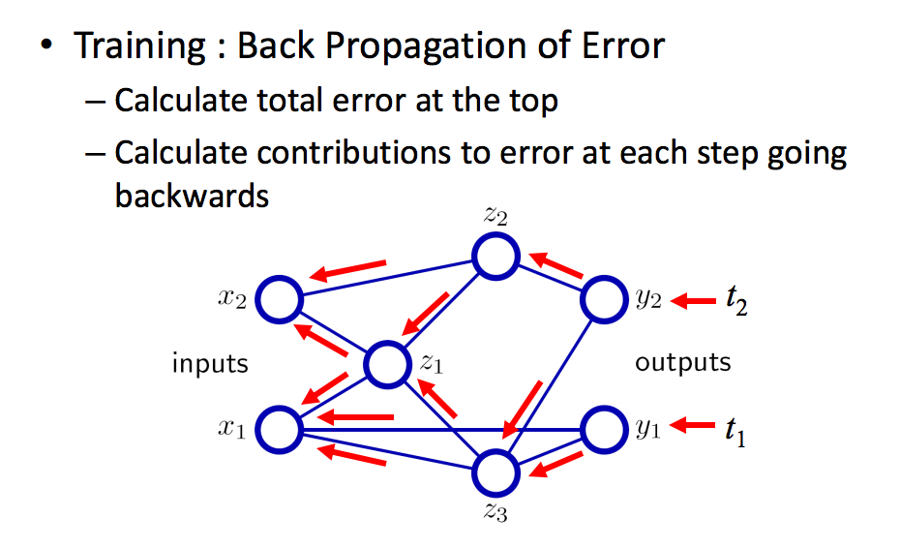
Backward Propagation Cartoon
Error ≈ Cost function J(θ)

Slide 45
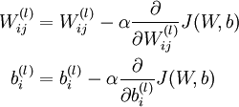
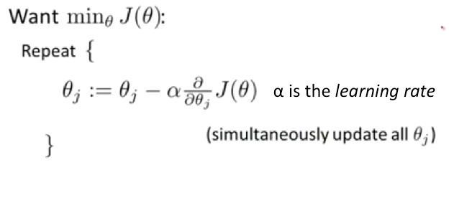
How do you (back) propagate the error?
Basic Idea: Iteratively minimize W^{(l)} and b^{(l)}
Usually written in vector form as

Slide 46
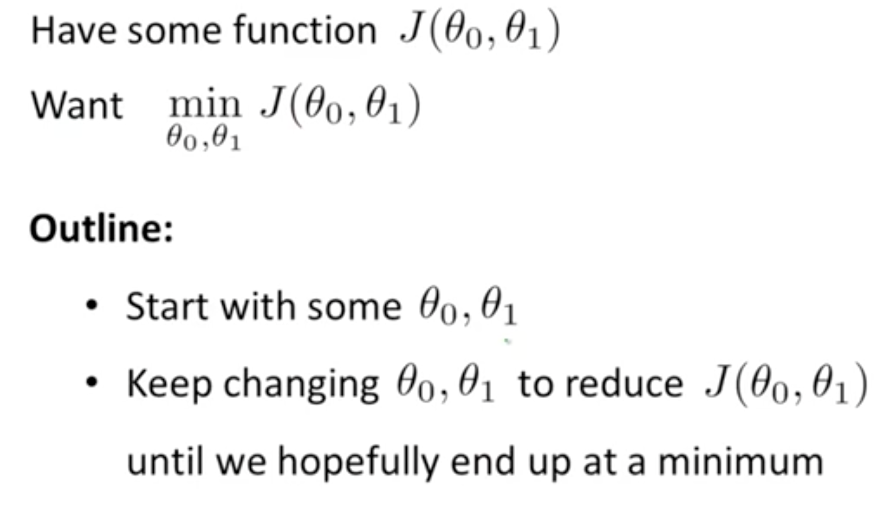
Backprop is a form of Gradient Descent Basic Idea
Why Hopefully?

Slide 47
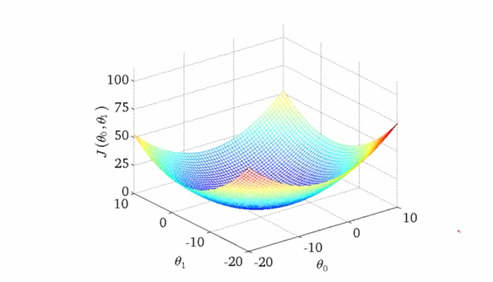
Gradient Descent Intuition 1 Convex Cost Function
One of the many nice properties of
convexity is that any local minimum
is also a global minimum

Slide 48
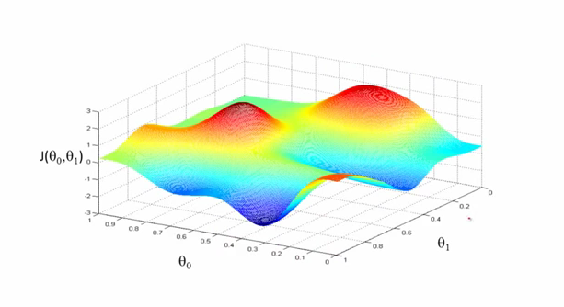
Gradient Decent Intuition 2
Unfortunately, any interesting cost function is non-convex

Slide 49
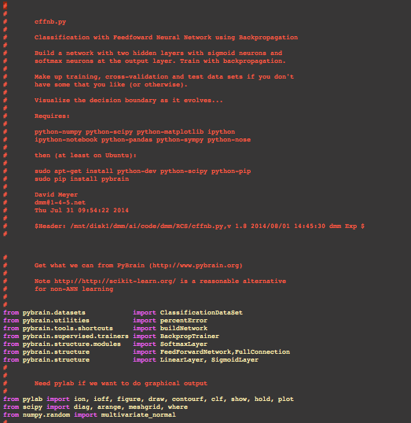
BTW, how hard is this to code up, say in python? http://www.1-4-5.net/~dmm/code/ai/

Slide 50
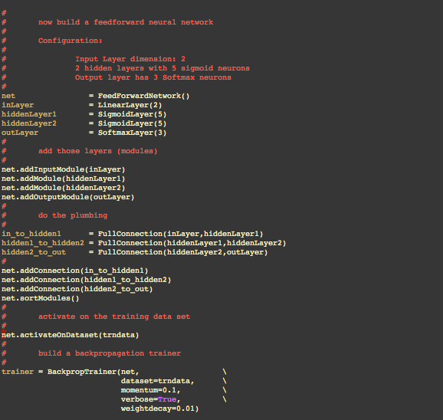
Building a FFNN http://www.1-4-5.net/~dmm/code/ai/

Slide 51
Agenda
Software Defined Intelligence
Very Brief Overview of Machine Learning
Artificial Neural Networks
Network-oriented Applications

Slide 52
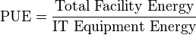
Google PUE Optimization Application¹
Straightforward application of ANN/supervised learning
Lots more happening at Google (and FB, Baidu, NFLX, MSFT,AMZN,…)
http://research.google.com/pubs/ArtificialIntelligenceandMachineLearning.html
Use case: Predicting Power Usage Effectiveness (PUE)
Basically: They developed a neural network framework that learns from operational data and models plant performance
The model is able to predict PUE² within a range of 0.004 + 0.005 , or 0.4% error for a PUE of 1.1.
“A simplified version of what the models do: take a bunch of data, find the hidden interactions, then provide recommendations that optimize for energy efficiency.”
http://googleblog.blogspot.com/2014/05/better-data-centers-through-machine.html
1 https://docs.google.com/a/google.com/viewer?url=www.google.com/about/datacenters/efficiency/internal/assets/machine-learning-applicationsfor-datacenter-optimization-finalv2.pdf
2 http://en.wikipedia.org/wiki/Power_usage_effectiveness

Slide 53
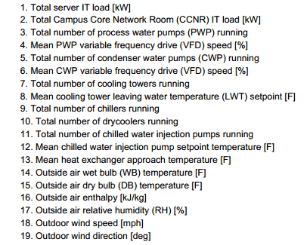
Google Use Case: Features
Number of features relatively small (n = 19)

Slide 54
Google Use Case: Algorithm
Randomly initialize the model parameters θ
Implement forward propagation
Compute the cost function J(θ)
Implement the back propagation algorithm
Repeat steps 2-4 until convergence
or for the desired number of iterations
Really undergraduate textbook stuff…

Slide 55
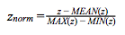
Google Use Case: Details
Neural Network
5 hidden layers
50 nodes per hidden layer
0.001 as the regularization parameter (λ)
Training Dataset
19 normalized input parameters (features) per normalized output variable (the DC PUE)
Data normalized into the range [-1,-1] (also know as feature scaling)
184,435 time samples at 5 minute resolution
O(2) years of data
70% for training, 30% for cross validation
Aside: Model Selection problem
Split into 3 parts: Training (60%), cross-validation (20%), and test sets (10%) →
Training error (J(θ)) is unlikely to be a good measure of how well hypothesis will generalize to new examples
i.e. overly optimistic of generalization error (pretty obviously; parameters fit to the training set)
Basically: test model on cross validation and test sets

Slide 56
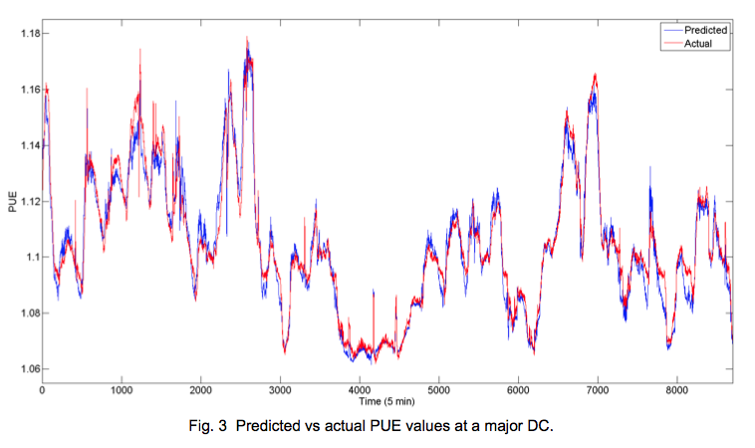
Google Use Case: PUE Predictive Accuracy
Mean absolute error: 0.004
Standard deviation: 0.005
Increased error for PUE > 1.14 due
to lack of training data

Slide 57
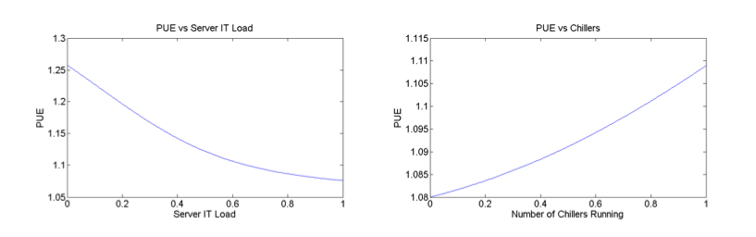
Google Use Case: Sensitivity Analysis
After the model is trained, one can look at effect of individual parameters by varying one while holding the others constant
The relationship between PUE and the number of chillers
running is nonlinear because chiller efficiency decreases
exponentially with reduced load.

Slide 58
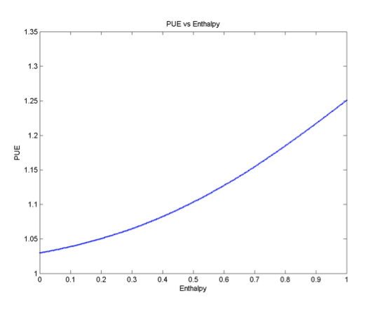
Google: Outside air enthalpy has largest impact on PUE
Relationship between PUE and outside air enthalpy, or total energy content
of the ambient air. As the air enthalpy increases, the number of cooling towers,
supplemental chillers, and associated loading rises as well, producing a nonlinear
effect on the DC overhead. Note that enthalpy is a more comprehensive measure
of outdoor weather conditions than the wet bulb temperature alone since it
includes the moisture content and specific heat of ambient air.

Slide 59
What Other Kinds Of Data Center Problems Can Be Treated This Way?
“Analytics”
Usually refers to a more “brute force” style of data analysis
Traffic Classification
Flow identification
Security (DDoS detection/mitigation)
QoE
Smarter IDS
Optimizing NFV-style Resource Utilization
Various parameters of around pooled resources
VRs, LBs, IDSs, …
General virtual networking optimization
Anomaly detection
Fault management, health indicators, …
Prediction
Risk management, capacity planning, …
Orchestration
Completely untouched
Anything having to do with IoT/Sensor Networking
Also untouched
Many more…just scratching the surface here

Slide 60
Smarter IDS?
Signature-based IDS detects what I already know
Very effective on what its programmed to detect
Cannot defend against unknown attacks
Very expensive (humans)
Anomaly-based IDS detects what differs from what I know
Can detect out-of-baseline attacks
Requires some kind of training/profiling
Robust and adaptive models difficult to construct
Unsupervised Clustering-based IDS
H_{θ}: Attacking flows are sparse and different than “normal” flows
Advantages
No previous knowledge required (signatures or labels)
No need for traffic profiling or modeling
Can detect unknown attacks
Major and necessary step towards self-aware monitoring

Slide 61
Q&A
Thanks!

